Slide 1
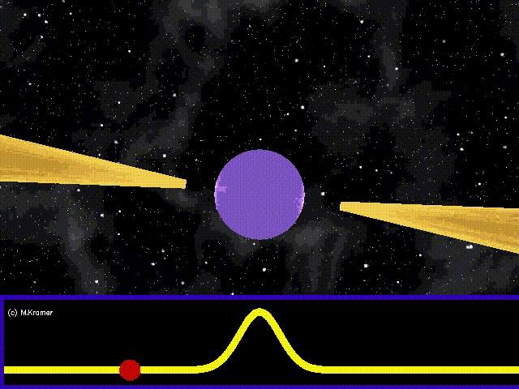
Machine Learning Driven Pulsar Search
报告人：SKA
上海市数据科学重点实验室
复旦大学计算机科学技术学院
Email:16210240085@fudan.edu.cn
Notes:
ska

Slide 2
Introduction to Data
HTRU1
1,196 known pulsar candidates from 521 distinct sources,
89,996 non-pulsar candidates
http://astronomy.swin.edu.au/~vmorello/
PMPS (over region between Fast and Parkes)
8123 potential pulsar files
117347 RFI candidates
P309

Slide 3
Introduction to Data
PMPS
 | Good_check | RFI | No | Unlabeled | Total
PMPS | 14461（183G） | 253552（2.6T） | 111720（1127G） | 30795（389G） | 410528（4.25T）
HTRU
 | pulsars | RFI | Total
HTRU1 | 1196 | 89996 | 91192
P309
 | pulsars | Non-pulsar | Total
p309 | 2698 | 1656 | 4354

Slide 4
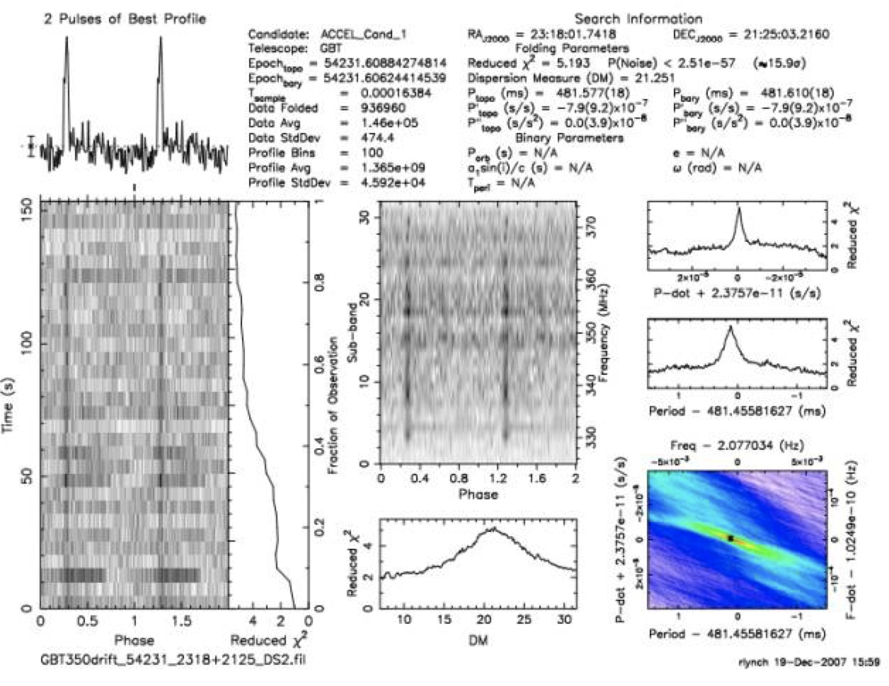
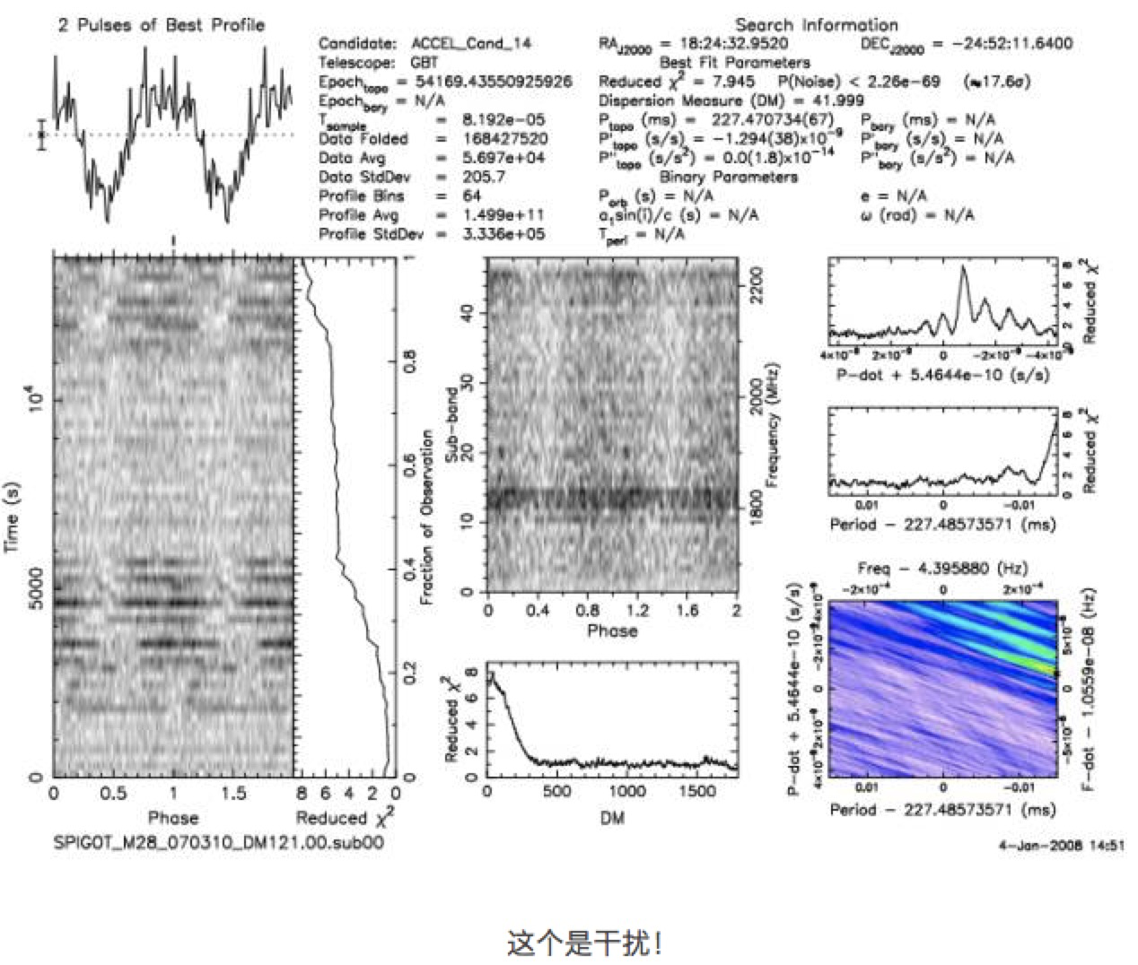
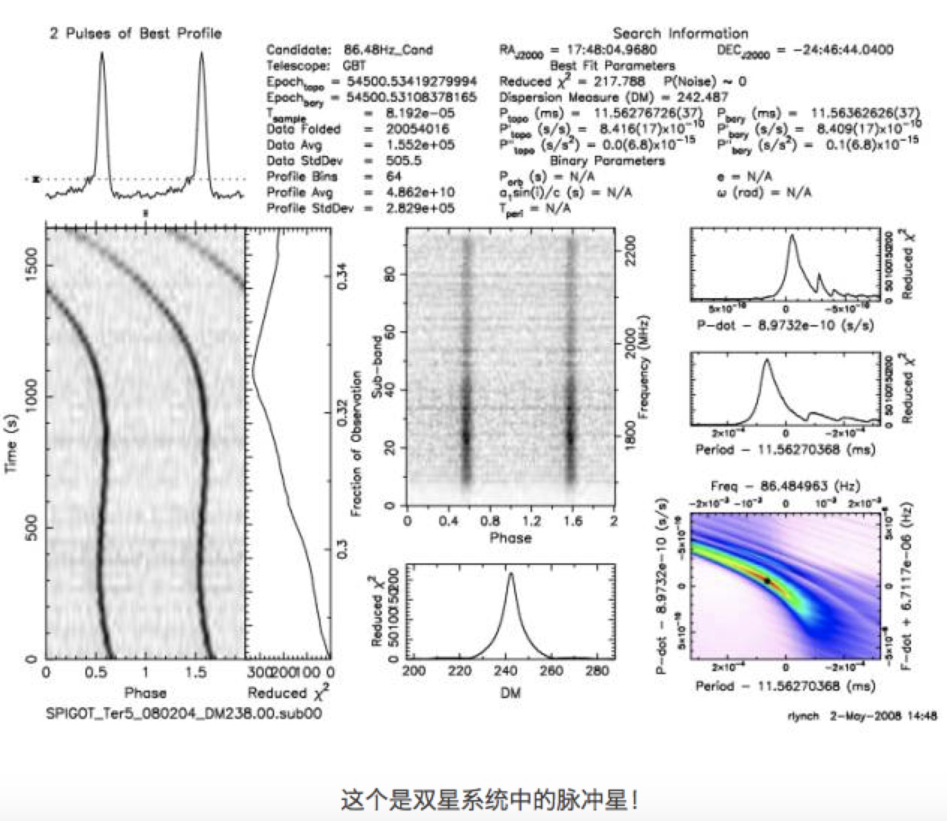
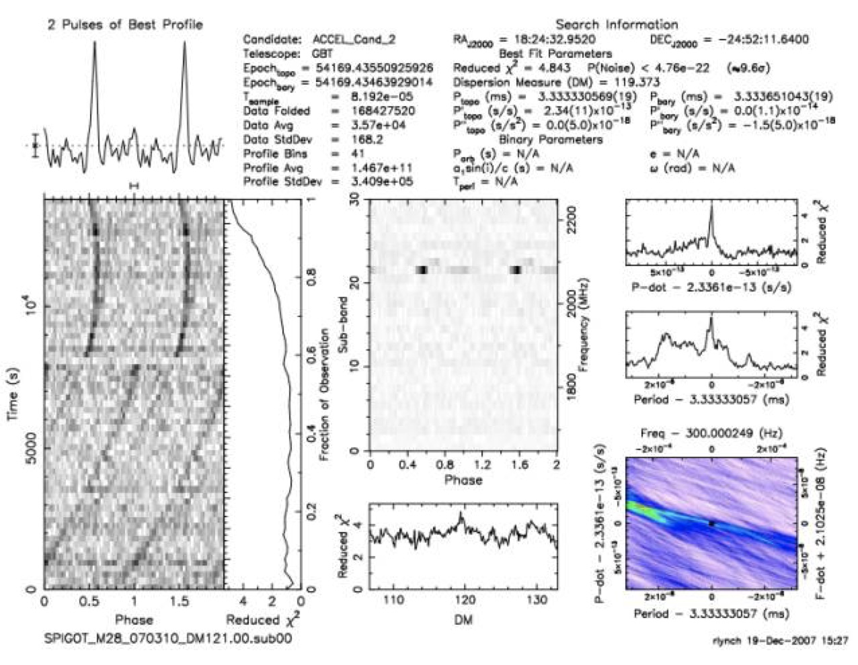

Introduction to Data
Pulsar
Non-pulsar
Pulsar
Non-pulsar

Slide 5
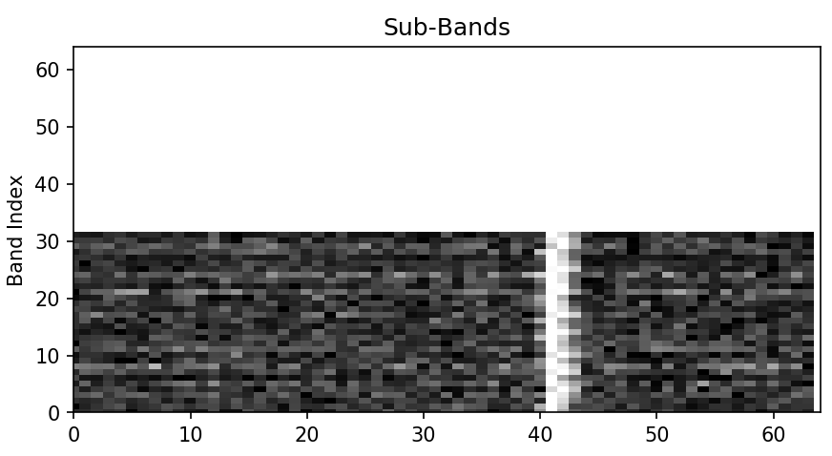
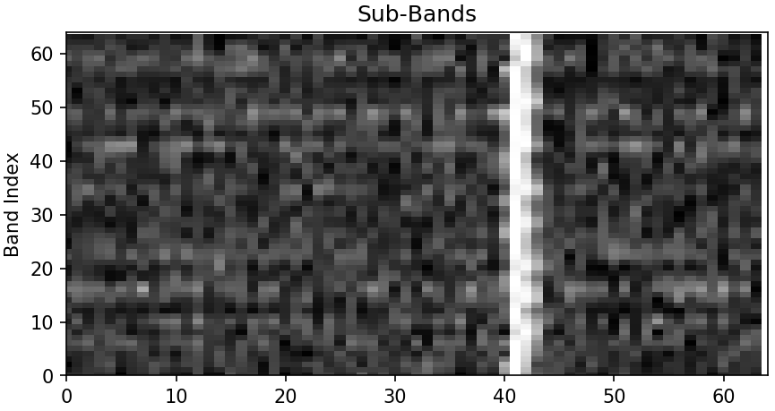
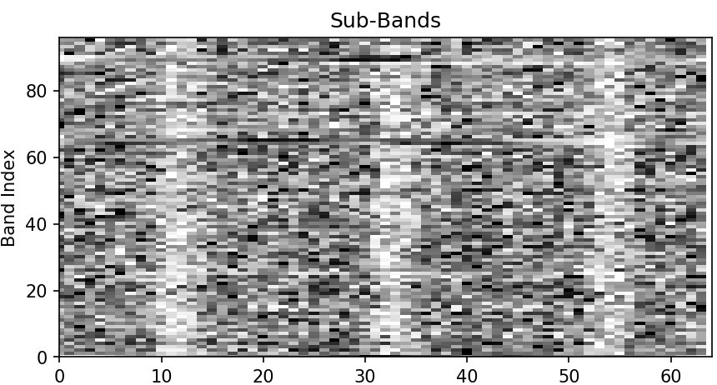
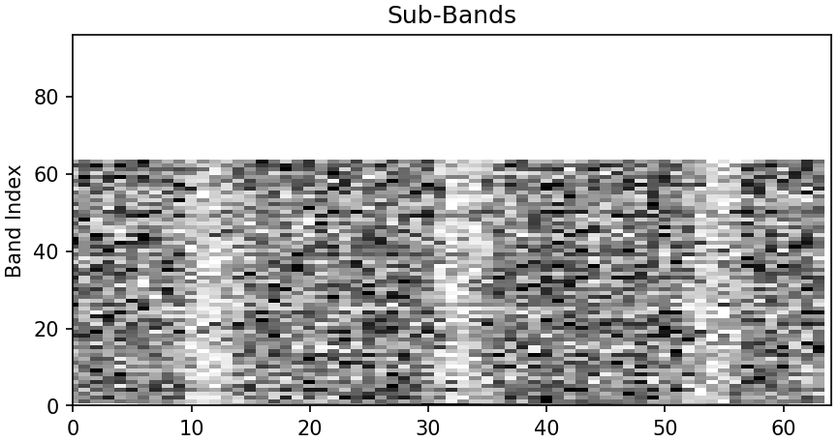
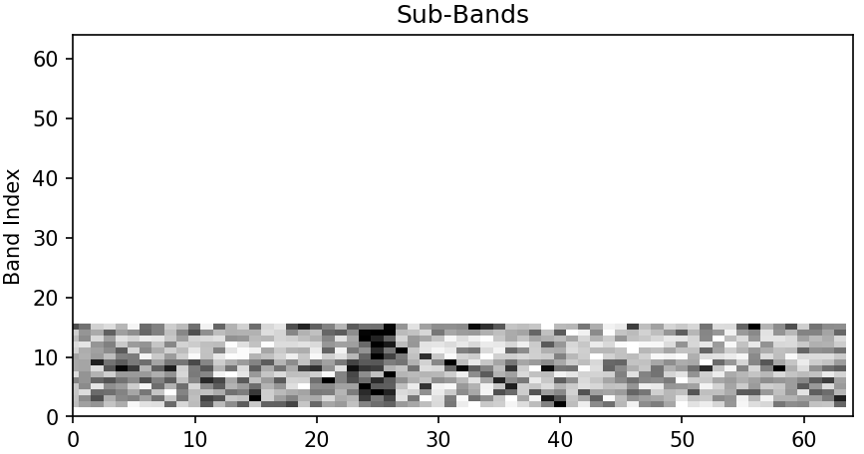
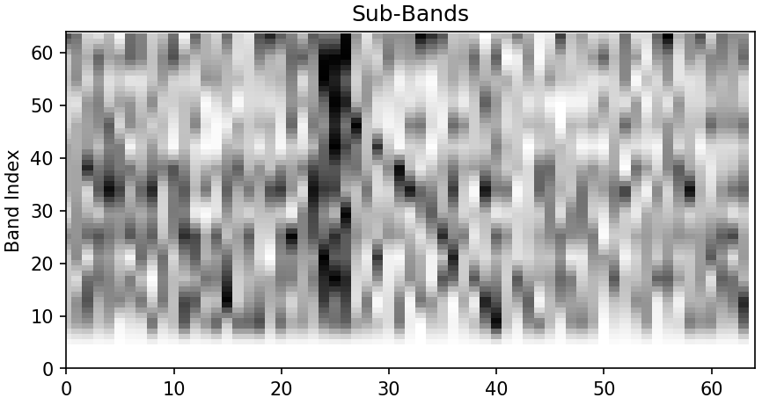
Introduction to Data
P309
32*64—64*64
96*64—64*64
PMPS
18*64—64*64
HTRU

Slide 6
Results
The Deep Learning Model
No 1.The Training Data: PMPS The Test Data: PMPS
No 2.The Training Data: HTRU The Test Data: HTRU
No 3.The Training Data: HTRU The Test Data: PMPS
No 4.The Training Data: PMPS The Test Data: HTRU
The Model in PICS
No 5.The Training Data: * The Test Data: PMPS
Experiment | Precision (%) | Recall (%) | F1 (%)
No1 | 70.8 | 77.8 | 74.2
No2 | 96.4 | 97.1 | 96.8
No3 | 57.9 | 78.8 | 66.7
No4 | 53.2 | 98.9 | 69.2
No5 | 98.0 | 18.9 | 31.7

Slide 7
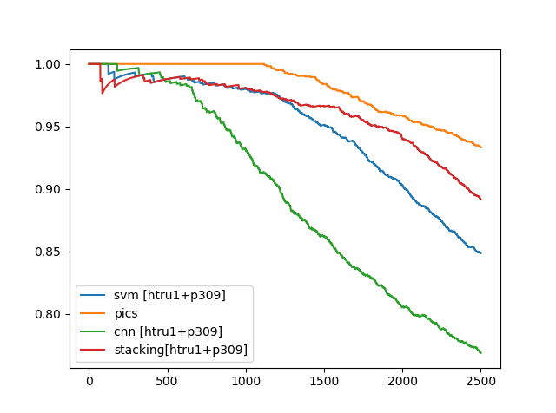
Evaluation
Precision@K
K = 2500

Slide 8
Evaluation
 | Positive | Negative
Positive | TP | FN
Negative | FP | TN

Slide 9
Evaluation
1
0.7
Precision
1
0.7
True Positive Rate
Random chance
0
Recall
Precision-Recall Curve
0
0.2
False Positive Rate
1
ROC Curve

